Slide 1


Audio/Video System
Quick Reference Guide
Multi-Purpose Room

Slide 2

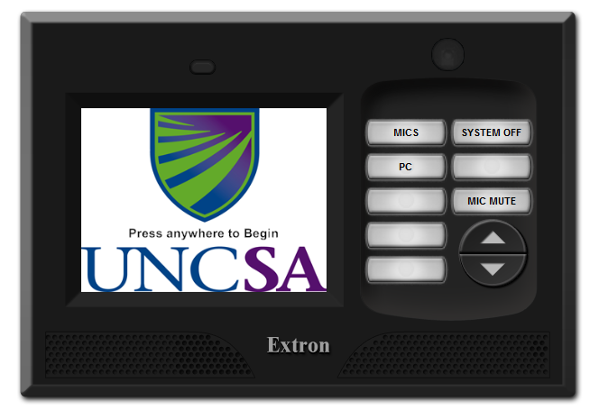
Start Page
When approaching the control panel it may be blank. Touch anywhere on the display section to bring up the start page.
To use the Audio system press anywhere on the Screen.

Slide 3
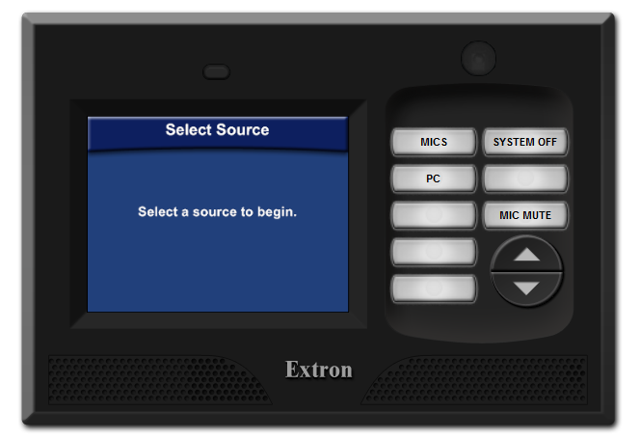
Main Page
Audio Sources
Brings up the Confirmation Page
Mutes Microphone Audio
Turn to the Left to Lower the PC Audio. Turn to the Right to Raise it.
After Starting the System, The Main Page will appear. Selecting a Button on the Right will allow you to choose what you Audio Source (Mic or PC) you want to hear where (MP Room, Lounge, and/or Lobby). By Default, when the system is powered on, the Mic and PC can be heard in all Three Spaces.

Slide 4
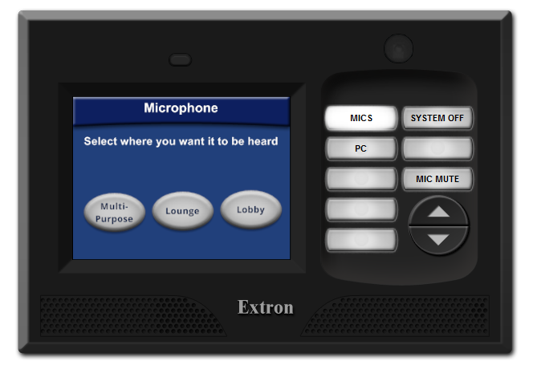
Mic Page
Destinations
Mutes Mic Audio
After Pressing the Mics Button, Mic Page will appear. Pressing one of the Destintation Buttons will allow the Mic to be heard in that area. Pressing it again will remove the Mic from that area.

Slide 5
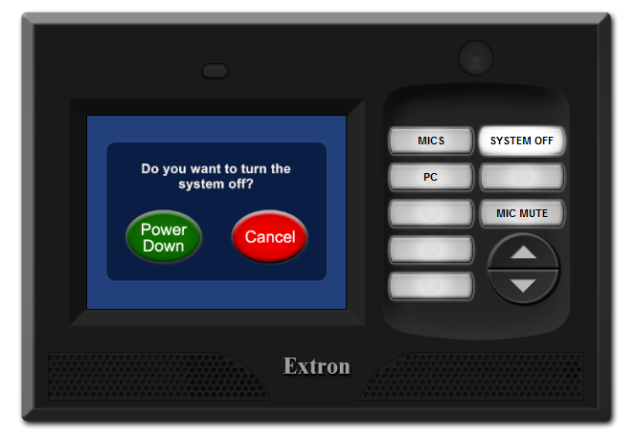
Power Down Page
From the Main Screen press the System Off button.
Then press the Power Down button to turn the system off.

Slide 6
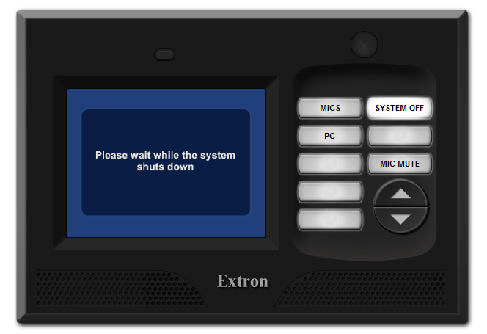
Shut Down Page
After pressing the Power Down button the screen above displays for 90 seconds while the system shuts down and then the Start page is displayed.

Slide 7
Service Resource Guide
Monitor is on but no image
Are all cables properly connected
Is laptop output toggled on?
Is the device turned on?
Call our office for service (336) 714-0564
I see the image but hear no sound
Check the “mute” button
Select and press volume up then volume down
Has someone turned the amplifier off at the rack
Call our office for service (336) 714-0564

Slide 8
Service Resource Guide
Nothing works
Was system power turned on from the touch panel power page?
Was there a recent power failure or surge. Check the power at the rack. Insure the power cord is plugged in?
Turn the rack off (Unplug the rack, then re-plug). The system may need to be re-set wait 90 seconds then try the touch panel.
Call our office for service (336) 714-0564

Slide 9
For Service, contact:
Tonya Allen at
(336) 714-0564 tonyaa@strategicmail.net

Slide 10
For Sales Contact:
Kevin Beach at (336) 714-0522
KevinB@strategicmail.net

